Slide 1
Fake News Detection
Presented by:
Batch :-16
Shiva Kumar --> 227R1A05J3
Lonka Srihitha -->227R1A05F7
Karthik Rodda --> 22D7R1A05J0

Slide 2
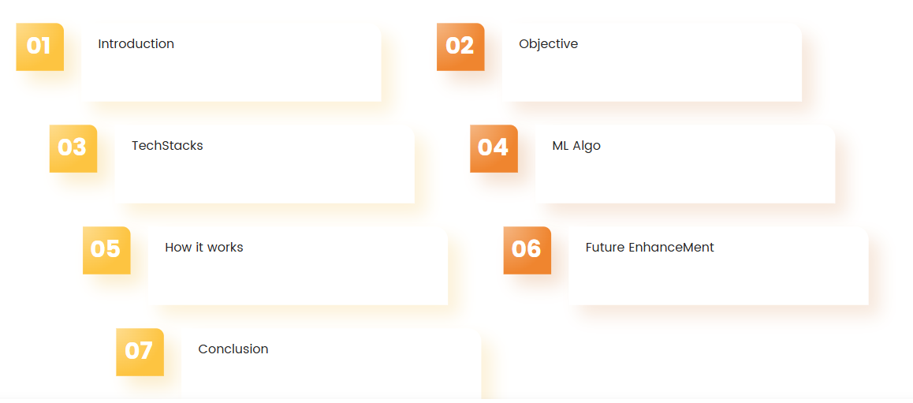
Content

Slide 3
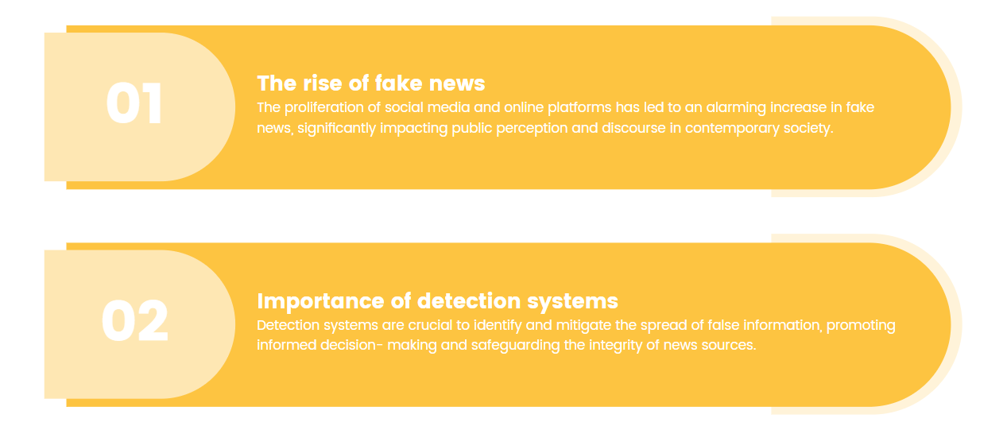
Introduction

Slide 4
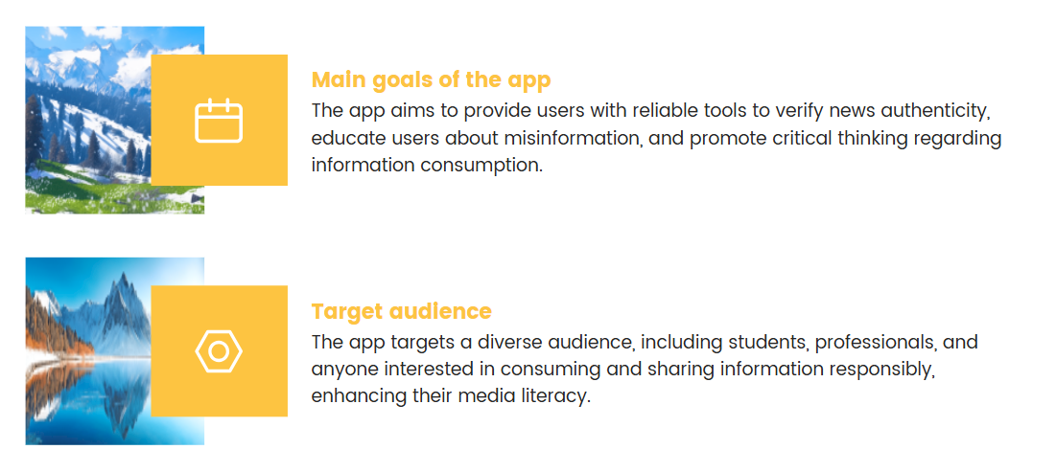
Objective

Slide 5

TechStacks
Backend
- Python Flask
- Scikit-learn
- Naive Bayes Classifier
- TF-IDF Vectorization
- Pandas & NumPy
Frontend
- Next.js
- TypeScript
- Tailwind CSS

Slide 6
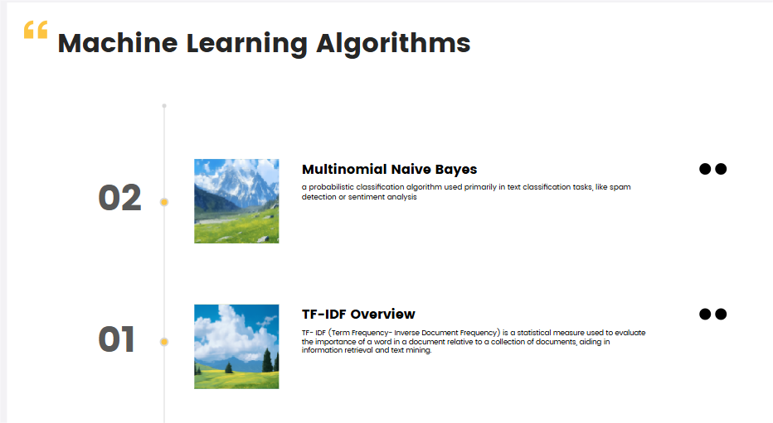

Slide 7
Hows Its Work
1. Text Preprocessing
- Lowercase conversion
- Special character removal
- Digit removal
- Whitespace normalization
2. Model Training
- TF-IDF feature extraction
- Naive Bayes classification
- Model persistence
3. Prediction Process
- Text input processing
- Feature vectorization
- Classification
- Confidence scoring

Slide 8
Future Enhancements
Larger training dataset
Multiple model support
Historical analysis
User feedback system
API documentation
Performance optimization

Slide 9
Conclusion
Effective fake news detection
Easy to use interface
Scalable architecture
Potential for expansion

Slide 10


